Slide 1
Hedtrot Perspective
Notes:
Vinicyus

Slide 2
What this project involves
Human interaction with technology
Virtual Reality
Augmented Reality
Videogames
3D environments
Notes:
Vinicyus

Slide 3
What is Virtual Reality
Advanced computer interface
Break the screen barrier
Real time interaction with virtual 3D environments
Notes:
Erick

Slide 4
What Virtual Reality uses
2 senses
Sight – with head-mounted displays
Sound – with 3D stereo headphones
Notes:
Erick

Slide 5
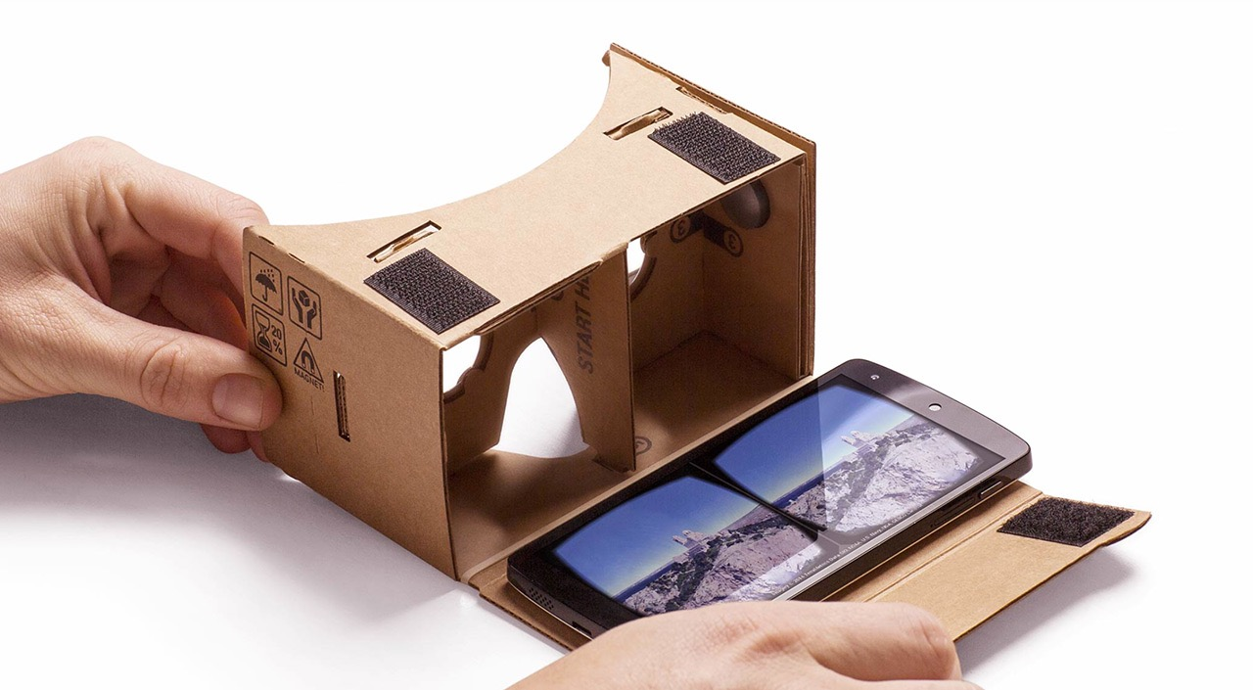
What Virtual Reality uses
Head-mounted displays
Example: Google Cardboard
Source: SlashGear
Notes:
Guilherme

Slide 6
What is Google Cardboard
A low budget head-mounted display made with Cardboard and 2 biconvex lenses
It is powered by Google Android and the Google Cardboard app
It separates the screen in two parts to create 3D images with depth
Notes:
Guilherme

Slide 7
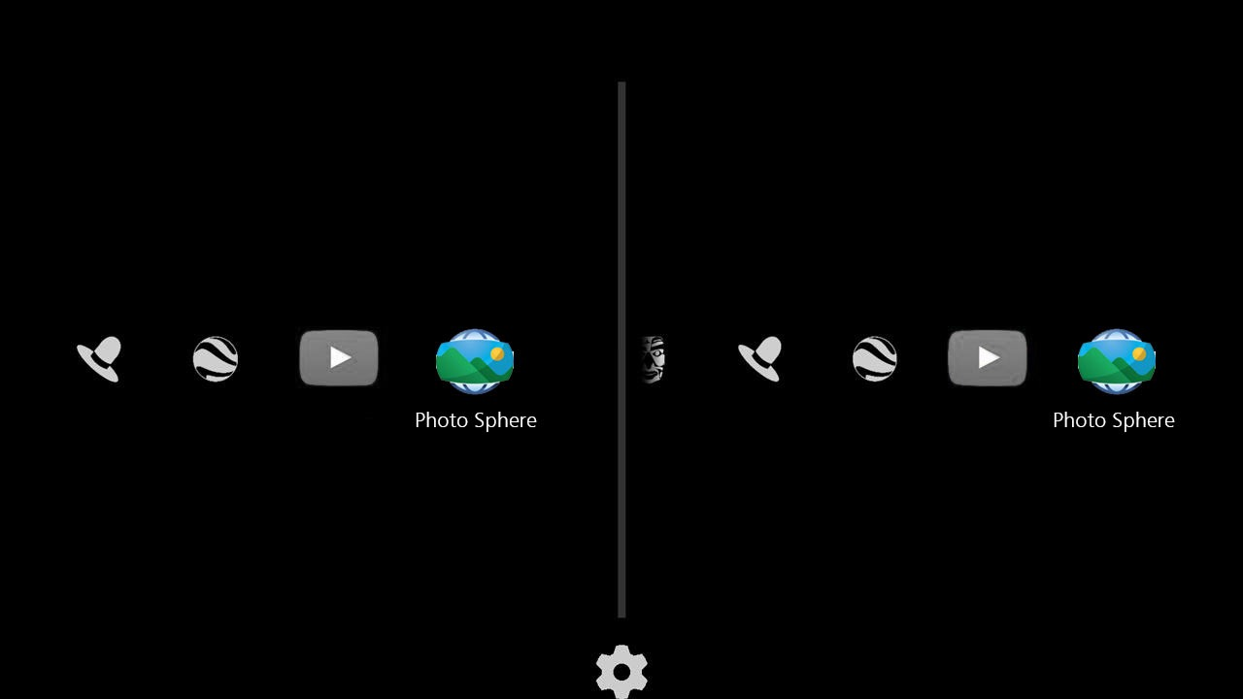
Source: Josh Pabst Photo
Notes:
Guilherme

Slide 8
What is Augmented Reality
Virtual extension of real environments (the physical world)
Augmented Reality expands the real world with computer-generated graphics
Notes:
Erick

Slide 9
Our software
Our software is called Perspective
We want to give the user a new perspective of the world
Notes:
Vinicyus

Slide 10
What is Perspective
Perspective is a platform for Augmented Reality-based games.
The purpose of Perspective is to keep the user in movement while having fun
It also has the purpose of stimulating logical thinking and creativity with virtual environments
Notes:
Vinicyus

Slide 11
What Perspective uses
It is being developed for Google Android smartphones
It uses the Google Cardboard technology
It uses the OpenCV technology
It uses the smartphone camera to track movements
Notes:
Jordan

Slide 12
What is OpenCV
It’s an “open source computer vision and machine learning software library” (OpenCV about webpage)
It has lots of algorithms that can be used to detect and recognize movements, objects, faces and other
Notes:
Erick

Slide 13
What Perspective has
It has simple Augmented Reality-based games like Chess and experimental games like Perspective Lab
The user can interact with these games with the smartphone camera
Notes:
Erick

Slide 14
What is Perspective Lab
Our first demo, where you can play with cubes (move them, break them, throw them, just using your hands)
Other than this demo, Perspective will also have other experimental apps
Notes:
Jordan

Slide 15
Problematization
Virtual Reality and Augmented Reality are technologies that have been around for many years.
They are becoming popular just nowadays.
Some people find it difficult to imagine themselves inside videogames Some people
Notes:
Guilherme

Slide 16
Companies are already making VR and AR platforms.
One of them is Google Cardboard
But Cardboard doesn’t have so many popular games.
Notes:
Guilherme

Slide 17
Perspective – Purpose
Make something that:
Introduce these technologies to users
Make the user merge into virtual worlds
Stimulate logical thinking, curiosity and creativity
Keep the user in movement
Notes:
Jordan

Slide 18
How are we doing it
We are using Google Cardboard to make Perspective immersive and cheap
We are using OpenCV to make the user interaction more natural
We are using Android because it is a popular platform and provides the Google Cardboard technology
Notes:
Vinicyus

Slide 19
Final Considerations
We will make something simple and cheap with open source technologies
We are moving forward to improve the real world with Augmented Reality technologies
We will be using Google Play Store to make those technologies more popular
Notes:
Vinicyus

